Slide 1

Recommender Systems
BI Tech Surgery | Oct 12th 2018 | Ankush Tale
Notes:
Skipping over many details to maintain abstraction as first time learners; disclaimer

Slide 2
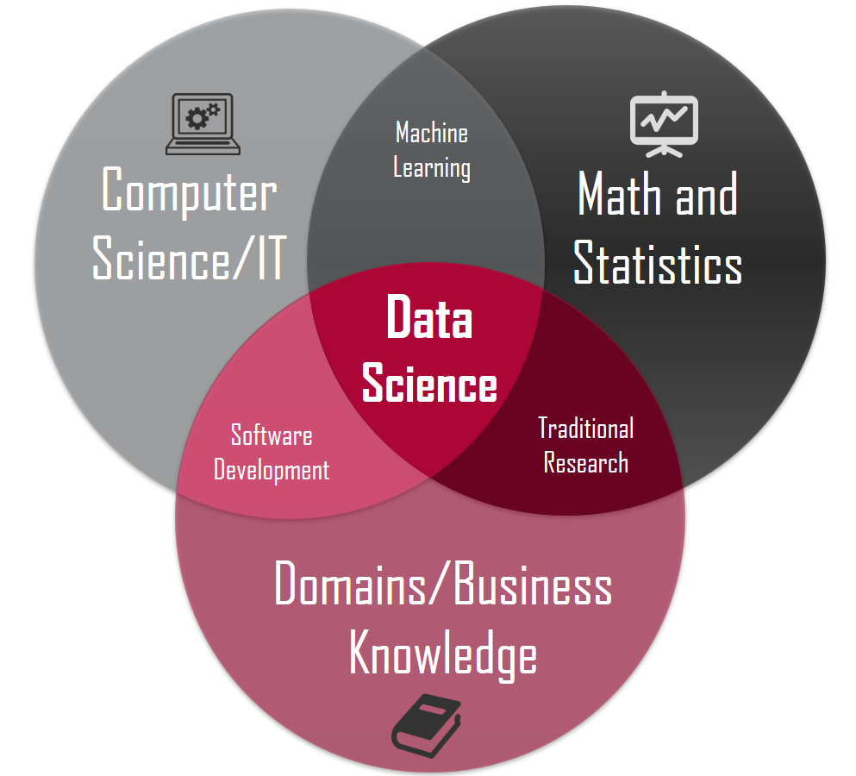
What is Data Science?
Notes:
joke

Slide 3
Machine Learning
P - Error
P - Error
90%
10%
Task T
Experience E
Task T
“A computer program is said to learn from Experience E to do a task T better,
measured by a performance metric P”
Notes:
Its just another function

Slide 4
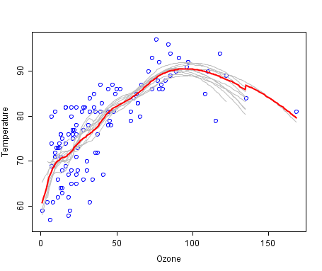
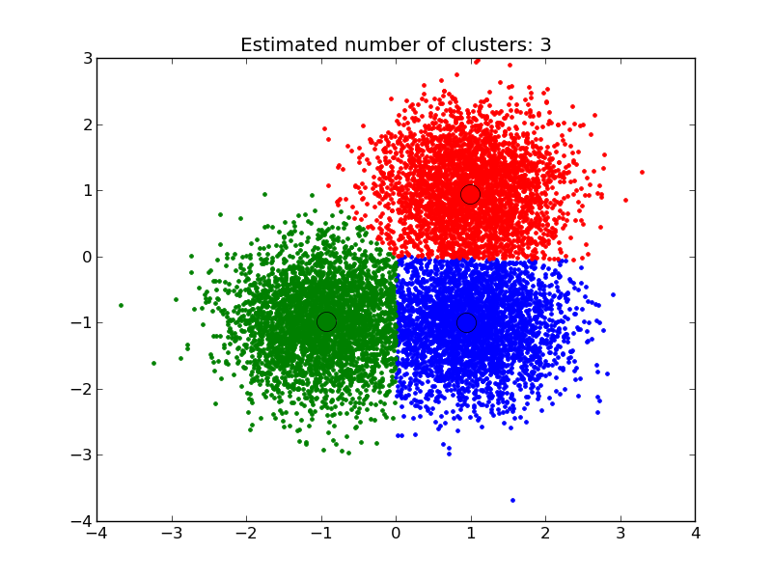
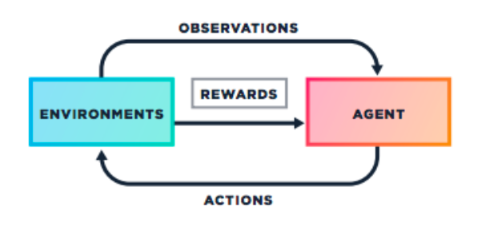
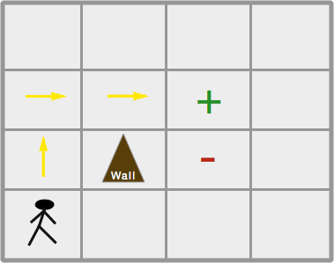
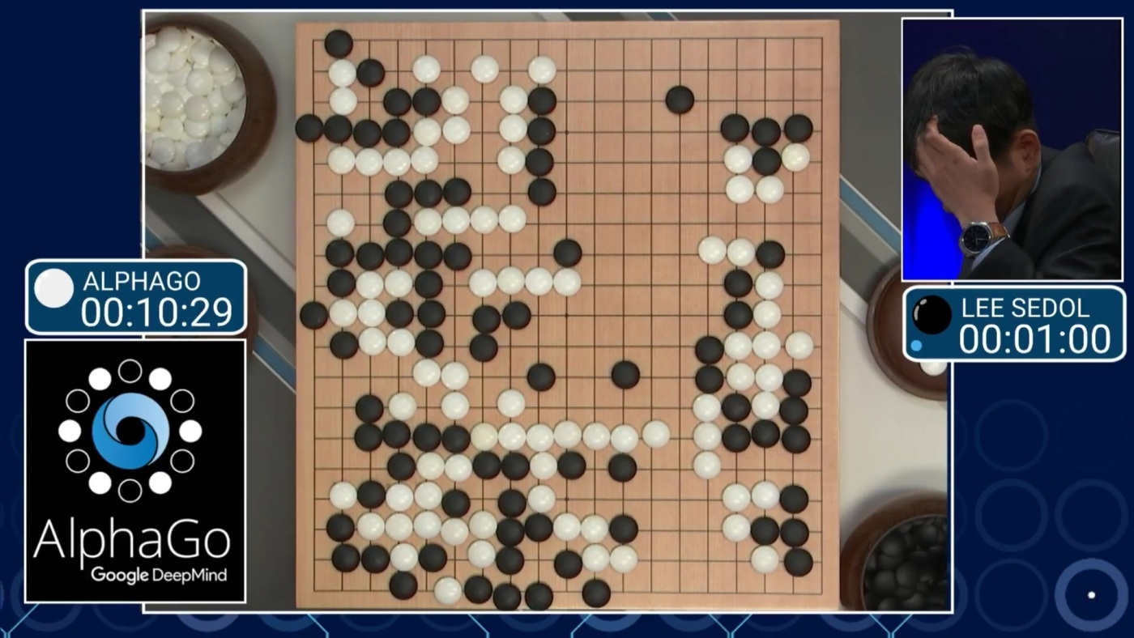
Types of Machine Learning Problems
Supervised Learning
Unsupervised Learning
Reinforcement Learning
Notes:
Ex: Fraud Predictions (features: diff in locations etc), Example of features
Clustering – how similar people can come together
Reinforcement – Football playing bots (video on youtube) (Explore and exploit)

Slide 5

Linear Regression
First step

Slide 6

Terms used
Data
Input (Features) (x)
Output (Target/Labels) (y)
Model
Linear, Logistic, Neural Net etc.
Parameters
y = mx + c
Loss / Error function (distance)
Loss / Error optimization algorithm (slope)
Notes:
Give example of Housing prediction

Slide 7
Regression
Data Model Parameters Loss Loss optimization
10
Predict House
Prices
X = Area
Y = Cost
y = mx + c
y = 1.x + c
y = x
20 Data Points
Notes:
Setup the problem
Experience of market. You have learnt over time.
Just give this data to comp

Slide 8
Regression
Data Model Parameters Loss Loss optimization
90
Predict House
Prices
X = Area
Y = Cost
y = mx + c
y = 36.x + 6
20 Data Points

Slide 9
Regression
Data Model Parameters Loss Loss optimization
90
Predict House
Prices
X = Area
Y = Cost
y = mx + c
y = 36.x + 6
20 Data Points
Notes:
Fit your estimation by asking people around

Slide 10
Regression
Data Model Parameters Loss Loss optimization
50
Predict House
Prices
20 Data Points

Slide 11
Regression
Data Model Parameters Loss Loss optimization
10
Predict House
Prices
20 Data Points

Slide 12
Regression
Data
Input (Sq. m. Area)
Output (Cost)
Model
Linear Regression
Parameters
y = 1x + 0
Loss / Error function (distance)
Loss / Error optimization algorithm (Decrease Slope)

Slide 13
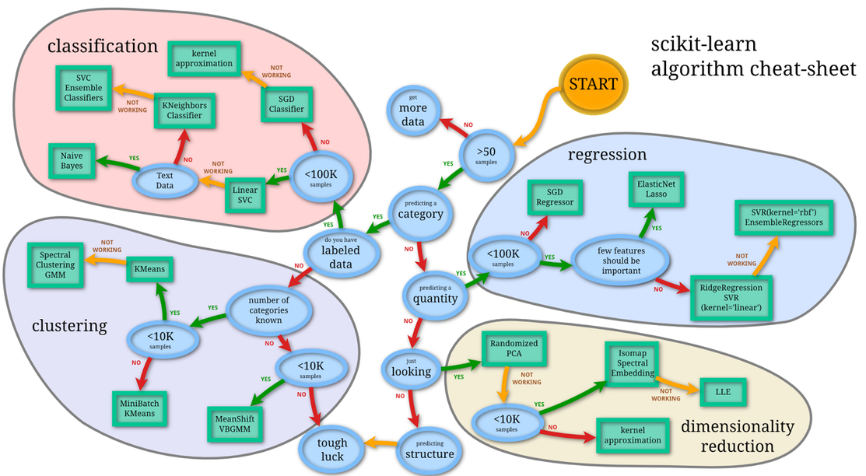

Slide 14
Recommender Systems

Slide 15


What is Recommender Systems?
It is an automated system which can recommend relevant items to the user based on his previous interactions with the other items in that system.
$1million - 10.09% improvement
Over CineMatch (Collab. Filt.)
Notes:
Search engines, information retrieval, E Commerce;

Slide 16


“Yesterday, I had half an hour of free time.”
“So instead of watching a movie, I spent half hour browsing for one”
- Albert Einstein
35% purchases you make on Amazon are influenced by recommendation systems
70% of videos that each user watching in youtube are recommended by Google Automated Recommendation Engine
75% of what people what people watching on Netflix is recommended content

Slide 17

NEED TO KNOW

Slide 18






Terms used
User
Item
Interactions

Slide 19
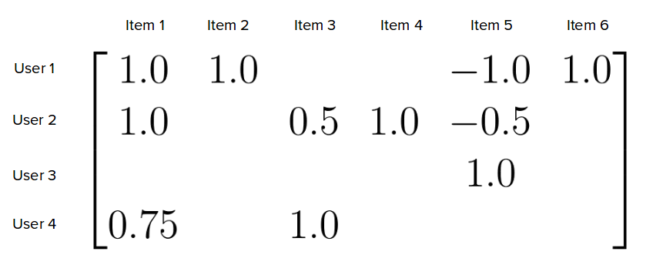
Matrix

Slide 20
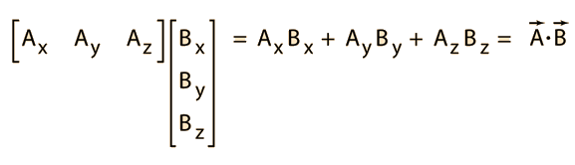
Dot Product

Slide 21
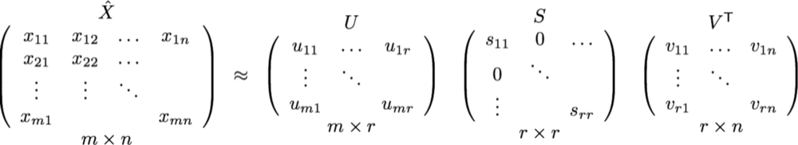
Singular Value Decomposition

Slide 22

HOW IT WORKS ?
Notes:
Companies profile you and your habits

Slide 23



THREE MAJOR METHODOLOGY
Content Based
Collaborative Filtering
Hybrid Systems

Slide 24


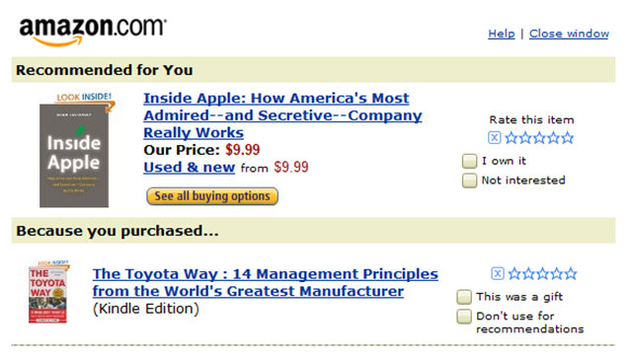
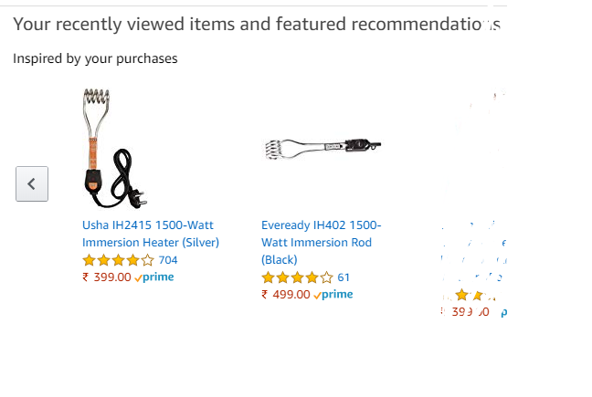
Content based filtering
The basic idea is: if you like an item then you’ll like a similar item

Slide 25
Example : Content Based
 | Action | Rescue | President
User 1 | 1 | 1 | 0
User 2 | 1 | 0 | 1
 | Action | Rescue | Preseident
Olympus | 1 | 1 | 1
White House | 1 | 1 | 0
London | 1 | 0 | 1
User Profile
Item Profile
 | Olympus | White House | London
User 1 | 2 | 2 | ?
User 2 | ? | 1 | 2
User Item Interaction
Notes:
Write down equation

Slide 26
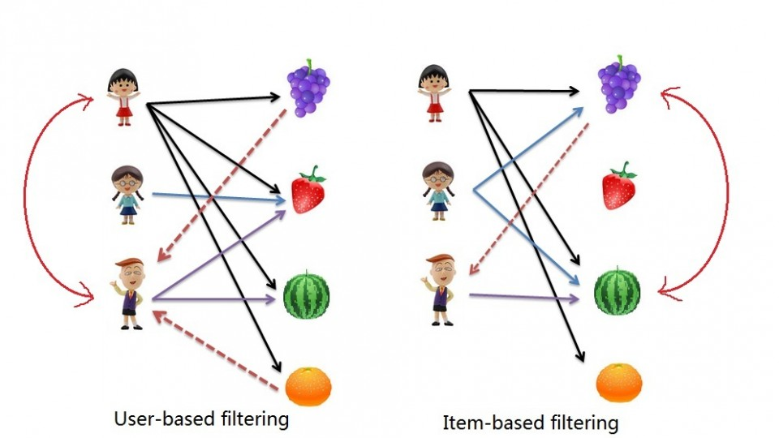
Collaborative Filtering
Based on the similarity in preferences, tastes and choices of two users.
It analyses how similar the tastes of one user is to another and makes recommendations on the basis of that.
Notes:
Virtual profiles of oyu

Slide 27
Example : Collaborative Filtering
 | Movie 1 | Movie 2 | Movie 3 | Movie 4 | Movie 5
User 1 | 2 | ? | 4 | 3
User 2 | 2 | 2 | 3 |  | 4
User 3 | 1 | 2 | 3 | 2
User Item Interactions

Slide 28
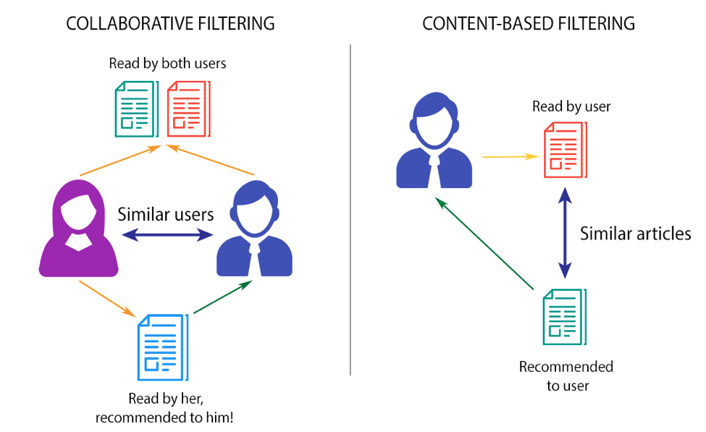
Recap

Slide 29
Tools
Surprise
Uses Matrix factorization
LightFM
Annoy - Approximate nearest Neighbor Oh Yeah!
FAISS - Facebook Artificial Intelligence Similarity Search
NMSLib - Non-Metric Space Library
ALS - Alternating Least Square using Implicit Library
Notes:
Packages are nothing but implementations in a reuseable way. Let’s create one of our own
Barclays users to recommend via Pingit

Slide 30

Demo time!

Slide 31
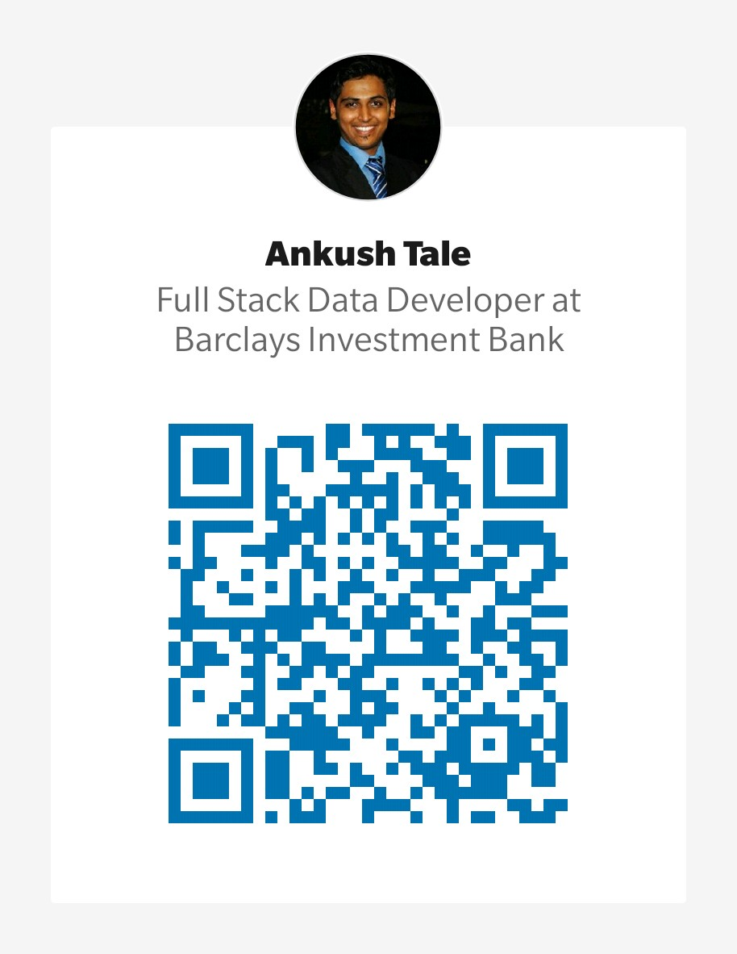
Thank you
Feedback much appreciated ☺
A Good read on this topic is James Le’s article: Link
GitHub links: Basics, using SVD, using Deep Learning
Stay back if you want to know how self-driving cars work ☺

